Slide 1
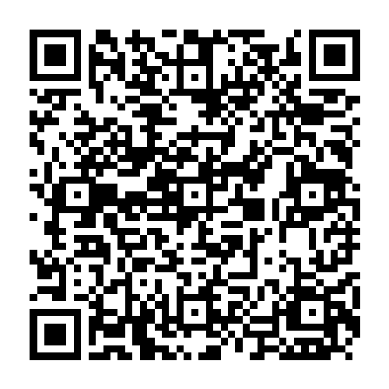
Stay Informed with the
Conference App
Fluoridation – Essential Information for Operators & Managers
Mark J. Bartson, P.E.

Slide 2
UC San Francisco
Oral Health Program - Fluoridation
Mark Bartson, P.E. Mark.bartson@ucsf.edu
Howard Pollick, BDS, MPH – UCSF Dental School Howard.pollick@ucsf.edu
Marjorie Stocks, MPH - Community Outreach Marjorie.stocks@ucsf.edu

Slide 3
What do we (UCSF) offer?
Help with challenging questions from the public
In-service training & briefings

Slide 4
Outline
Regulatory requirements
State Water Board field review
Results of UCSF Operator Survey
Training Resources & References

Slide 5
Essentials for Success
Understand Regulatory requirements
Be aware of specific permit requirements
Have current Operations & contingency plans
Communicate with regulators

Slide 6
Percentage of population fluoridated water
National | 73%
California | 58%

Slide 7
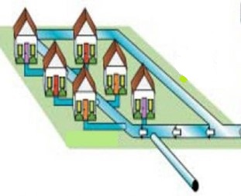
Water System Schematic
Source 1
Flow & Fluoride

Slide 8
Water System Schematic
Source 1
Source 2
Flow & Fluoride level
Flow & Fluoride level

Slide 9
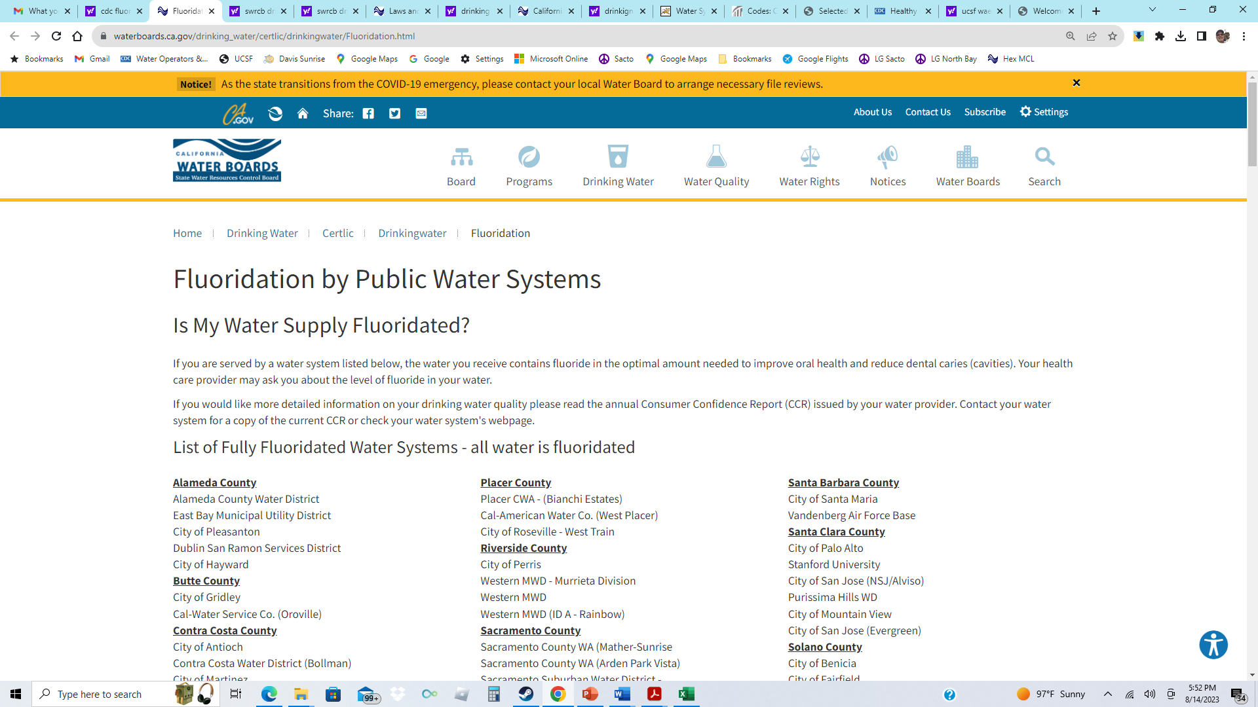

Slide 10
"List of Fully Fluoridated Water Systems – all water is fluoridated”
Optimal amount of fluoride in water
Refer to Consumer Confidence Report (CCR)
Contact your water system for more info….

Slide 11
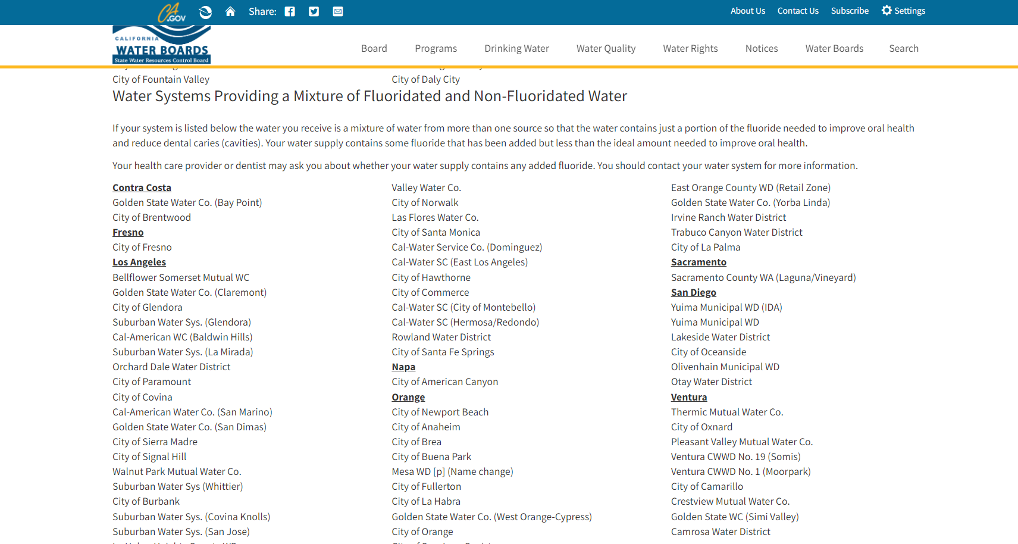

Slide 12
Water System Schematic
Fluoride treatment system
Fluoride treatment system
Source 2

Slide 13
What is the fluoride level?
Zone 2 = 0.2 mg/l (?)
Zone 1 = 0.5 mg/l (?)
500 gpm @ 0.6 mg/l
1,000 gpm @ 0.1 mg/l

Slide 14
Typical reasons for Partial Fluoridation
Seasonal use of local lources (that are not fluoridated)
Peak demand use of non-fluoridated water
Only the purchased water is fluoridated.

Slide 15
Mixture of Fluoridated and Non-Fluoridated Water “Partially Fluoridated”
Mixture of water from more than one source
Less than the ideal amount needed
Contact your water system for more info….

Slide 16
California Statistics
Number of community systems | ~2,950
Number that are FULLY fluoridated | 91
Number that are PARTIALLY fluoridated | 79
Percentage of population receiving fluoridated water | 58%

Slide 17
1. Regulatory Requirements
Review of Regulations
Monitoring & Reporting requirements
Permit requirements
SWRCB system review & approval

Slide 18
State Regulations on Fluoridation
64433 | System Requirements and Exemptions
64433.2. | Optimal Fluoride Levels
64433.3 | Monitoring and Compliance--Fluoride Levels
64433.5 | Fluoridation System
64433.7 | Record-keeping, Reporting, and Notification
64433.8 | Fluoridation System Operations Contingency Plan
64590 | Drinking Water Direct Additives
Notes:
The sanitary survey includes an in-office file review and a physical field visit inspection.

Slide 19
Optimal Fluoridation level State Water Board Current Guidance – Differs from regulation
Optimal level of 0.7 mg/L
Control range of 0.6 ppm to 1.2 ppm
Consistent with Federal Center for Disease Control Guidance
Incorporated as a Water Supply Permit requirement

Slide 20
Fluoridation Systems
Operate only when a flow of water is detected.
Designed to meet the control range 95 per cent of the time;
Provide for containment of spills; and
Provide alarm features for fluoride chemical feed and fluoride spills.

Slide 21
Contingency Plans
Fluoride levels in the distribution system are found to be:
Above the control range
Above 4.0 mg per liter
Above 10.0 mg per liter
The procedures for shutting down the fluoridation if there is an overfeed
The procedures for investigating the cause of an underfeed or overfeed

Slide 22
64590 - Direct Additives
No chemical or product shall be added to drinking water by a water supplier unless … certified as meeting the specifications of NSF International/American National Standard Institute (NSF/ANSI) 60
Notes:
The sanitary survey includes an in-office file review and a physical field visit inspection.

Slide 23
SWRCB Reporting Forms
Monthly Distribution Monitoring
Year-to-Date Distribution Summary
Monthly Treatment Summary
Yearly Treatment Summary

Slide 24
Types of Fluoridation
1. Fully fluoridated
Partially fluoridated
3. Naturally fluoridated
4. Non-fluoridated

Slide 25
Water Supply Permit Requirements
Every public water system must have a valid permit
An amendment is required to modify treatment facilities
The permit can be enforced directly
Permit often contains system-specific requirements

Slide 26
2 - State Water Board Field Review
Physical condition of facilities
Operation & Maintenance
Record keeping
Operator Certification (and training)

Slide 27
Water System Inspections (Sanitary surveys)
Inspections are a regulatory tool
USEPA requires once every three years
Requirements & Recommendations are provided

Slide 28
Sanitary survey Elements
Sources of supply
Treatment
Distribution system
Water storage
Pumps and controls
Monitoring, reporting, and data verification
System management and operation
Compliance with operator certification requirements.
Notes:
The sanitary survey includes an in-office file review and a physical field visit inspection.

Slide 29
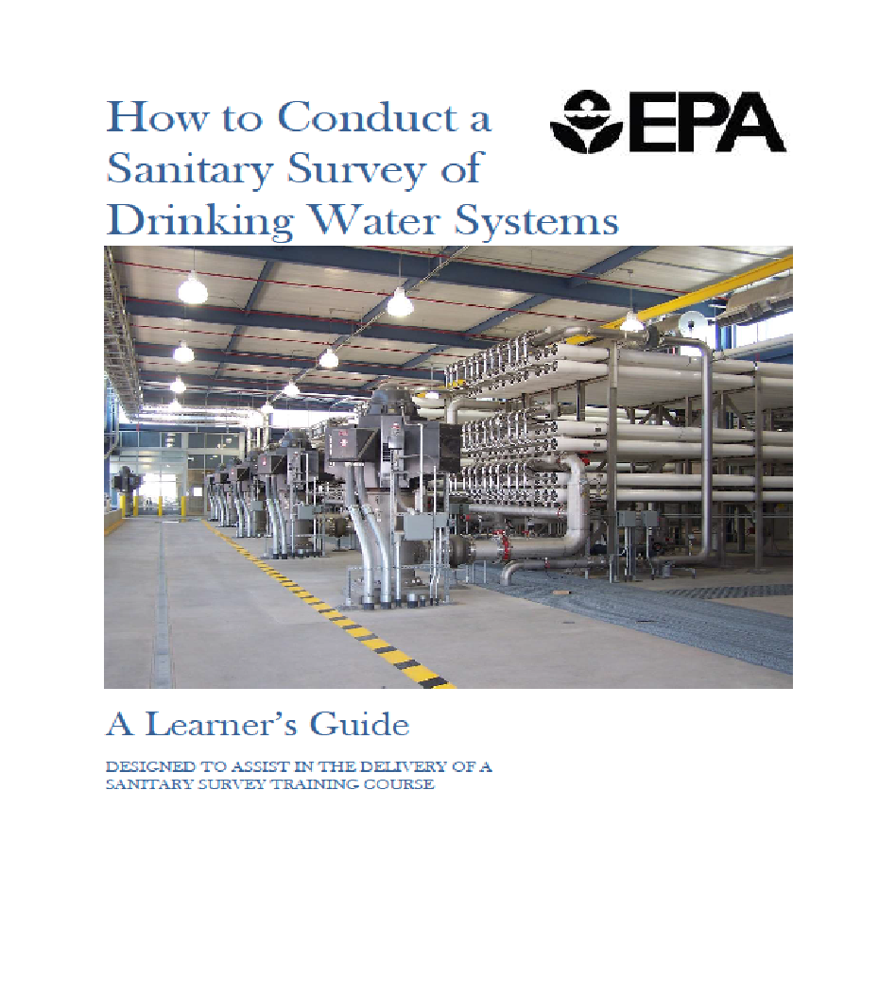
Sanitary Survey

Slide 30
Can the operator answer basic questions?

Slide 31
Evaluation questions (1)
Is there a proper concentration of fluoride in the distribution system at all times?
Does the operator test fluoride concentrations in the system daily?
Does the fluoride concentration vary from day to day?

Slide 32
Evaluation questions (2)
Does the operator perform testing correctly?
How often does the operator calibrate the testing instrument?
Is the calibration done properly?

Slide 33
Evaluation of Operator Capability
An operator’s lack of knowledge about the process and equipment is an indication that problems may not be resolved in a timely manner.

Slide 34
Evaluation of Operator Capability
Management is responsible for ensuring only well-trained staff operate and maintain the fluoridation equipment.

Slide 35
Evaluation of Operator Capability
Surveyors may consider a lack of knowledge of this key process as a MAJOR deficiency.

Slide 36
3 – UCSF Operator Survey

Slide 37
Operator Survey
Developed and carried out by UCSF research team
Survey emailed in Fall, 2023 to over 10,000 public water system contacts
Anonymous survey consistent with UCSF protocols
Analysis of survey is underway – Final report in late 2024
Survey results will help guide Continuing Education

Slide 38
What resources have you used for continuing education?
Peer reviewed literature
AWWA and other professional journals
Peer to peer communications
Information from the Centers for Disease Control website
Sacramento State Office of Water Programs courses

Slide 39
Challenges related to fluoridation system
Metering pump issues; saturator clogging
Corrosion of equipment
System design
More training needed on safety, sampling and operation

Slide 40
Challenges related to fluoridation system
There is a need for more continuing education on water fluoridation.
Existing trainings focus on OSHA regulations.
More comprehensive educational programs are needed

Slide 41
4 - Training Resources & References

Slide 42
Essentials for Success
Understand regulatory requirements
Be aware of specific permit requirements
Have current operations & contingency plans
Communicate with regulators

Slide 43
CDC Online Training Course

Slide 44
Essential References
SWRCB Permit documents & reviews
AWWA M4 Fluoridation Manual - Principles & Practices
CDC Engineering and Administrative Recommendations
System-specific documents : Operations, Maintenance, Safety

Slide 45
AWWA Water Fluoridation M4 Manual
Principles & Practices - 6th Edition
“Essential information for decision makers, engineers, and water utility operating personnel”

Slide 46
AWWA Manual Chapters
Water Fluoridation
Health and the Human Body
Fluoride Products
System Planning
Design, Equipment, and Installation
Operations and Maintenance .
De-fluoridation and Managing Fluoride Levels
Small Systems Considerations
Community Outreach and Communication

Slide 47
AWWA Manual - Operations
Operational Strategies
Compliance Monitoring
Fluoride (Manual) Ion Specific Electrode (ISE) Method
Colorimetric SPADNS Method
Ion Chromatography
Relative Error
Record Keeping and Documentation
Operator Safety in Handling Fluoride Products

Slide 48
AWWA Opflow Articles - 2020
Water Fluoridation Basics: What Operators Need to Know
Basics of Water Fluoridation Measurement and Additive Safety
Basics of Water Fluoridation Additive Products
Basics of Water Fluoridation Regulations

Slide 49
Essential Information - SWRCB
Water Supply Permit Law | https://www.waterboards.ca.gov/laws_regulations/docs/drinking_water_code_2021.pdf
SWRCB Fluoridation Web Page | https://www.waterboards.ca.gov/drinking_water/certlic/drinkingwater/Fluoridation.html
Fluoridation Regulations | 64433.3. Monitoring and Compliance—Fluoride Levels.
 | 64433.5. Fluoridation System.
 | 64433.7. Recordkeeping, Reporting, and Notification for Water Systems Fluoridating.
 | 64433.8. Fluoridation System Operations Contingency Plan.
Reporting Forms | https://www.waterboards.ca.gov/drinking_water/certlic/drinkingwater/Fluoridation.html

Slide 50
What do we (UCSF) offer?
Help with challenging questions from the public
In-service training related to fluoridation

Slide 51
UC San Francisco
Oral Health Program - Fluoridation
Mark Bartson, P.E. (707) 318-5461 Mark.bartson@ucsf.edu
Howard Pollick, BDS, MPH – UCSF Dental School Howard.pollick@ucsf.edu
Marjorie Stocks, MPH - Community Outreach Marjorie.stocks@ucsf.edu

Slide 52
AWWA Fluoridation Policy Statement (continued)
“AWWA supports the application of fluoride in a responsible, effective, and reliable manner that includes monitoring and control of fluoride levels mandated by provincial, state, and/or federal laws and which is subject to community acceptance through applicable local decision making processes. AWWA supports regular reviews of the most current research on fluoride and the positions of the medical and dental communities.”

Slide 53
AWWA Fluoridation Policy Statement
Supports the recommendations of the World Health Organization (WHO), American Medical Association (AMA), Canadian Medical Association (CMA), Centers for Disease Control (CDC), American Dental Association (ADA), and Canadian Dental Association (CDA), for the fluoridation of public water supplies as a public health benefit…

