Slide 1

Sonoma County Lessons
School Based Sealant Webinar
May 14th 2019
75% Cavity Free 5 Year Olds by 2020
Kim Caldewey, PA, MPH
Dental Health Program Manger
Andrea Pickett, MPH
Health Information Specialist II
Sonoma County Dental Health Program

Slide 2
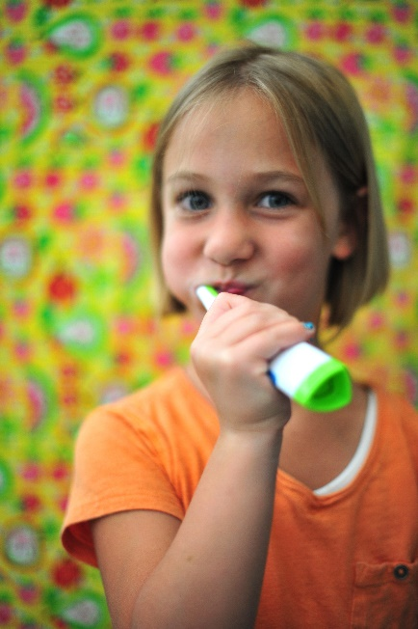
The Problem:
Dental disease is the most chronic yet preventable health care need among children in California.
In Sonoma County, over half of all kindergarteners have experience dental decay and by third grade, this disease affects nearly 70 percent.
Untreated decay can cause serious infections requiring costly and traumatic treatments.
Oral surgery under general anesthesia is performed on over 100 children each month at one surgery center alone.
Notes:
We often begin our presentations with statistics, to show how our children are plagued by decay and infections. Today I’d like to share with you the words of a teacher and a principle, who understand how school success is intricately tied to health, including dental health.
Teacher: “I heard a story from another teacher that one of her students was not getting any work done because he was hungry. He was hungry because he was not eating. He was not eating because his teeth hurt whenever he ate because they were in such bad condition.”
Principle, when asked about the importance of dental health: “It’s very important because if you have a toothache, you can’t pay attention.”
Our limited local data confirms what we already suspected was true, dental disease is a significant problem in Sonoma County.
In fact, it is a problem nation wide….most common health problem of childhood, more common than asthma.
And it has serious impact on one’s well being with effects on learning, development, individual health and community health.

Slide 3
Over half of kindergarten and third grade students
start school with tooth decay
Notes:
The results are disheartening….More than half of the students have already been affected by dental disease, 3rd graders more likely than kindergarteners (as expected), but notably a disproportionate number of Latino and low income children are affected.
Our best source of data on dental health in our community is from surveys we’ve done locally.
The Department of Health Services commissioned dental health surveys of kindergarten and third graders in 2009, and again in 2014. In both Smile Surveys, randomly sampled schools throughout the county were visited by dental professionals who examined kindergarten and third grade students
Survey was done in 15 schools, examined 1582 children, looked at 4 indicators:
Presence of tooth decay
Presence of untreated tooth decay
Presence of sealants
Need for dental care
The results are disheartening….More than half of the students have already been affected by dental disease, 3rd graders more likely than kindergarteners (as expected), but notably a disproportionate number of Latino and low income children are affected.

Slide 4
2014 Sonoma Smile Survey
Notes:
Furthermore, much of the decay that these children are experiencing is not being treated.
Eighteen percent (18%) of all students had untreated decay. This breaks out unevenly as more Hispanic/Latino students have untreated decay than whites and students in schools with a higher percentage of children participating in FRLP have higher decay rates.
It’s shocking to know how many children in our county have severe disease needing treatment.
The PDI Surgery center is performing surgery under general anesthesia on up to 12 Sonoma county children each week. The average age of the child is 3-1/2 years and the number of decayed teeth is averaged at 11. Children who have had several teeth extracted may have difficulty with eating healthy foods and in language development.

Slide 5
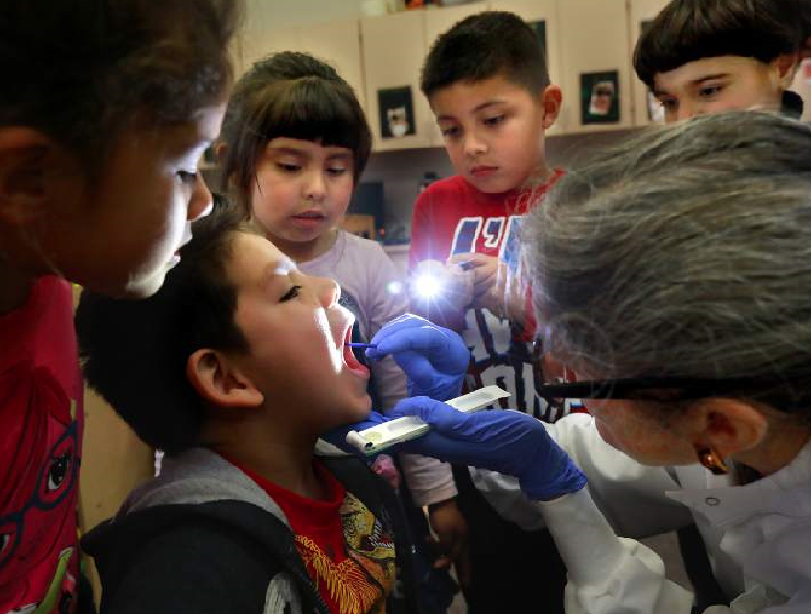
An Effective Solution: School Sealant Programs
School-based dental sealant programs are a highly effective way to deliver sealants to children who are less likely to receive private dental care.
Programs that deliver sealants to children at high risk for tooth decay also save money.
Each tooth sealed saves more than $11 in dental treatment costs.¹
Centers for Disease Prevention and Control. Vital signs: dental sealant use and untreated tooth decay among U.S. school-aged children. MMWR. 2016;65(41):1141–1145. https://www.cdc.gov/mmwr/volumes/65/wr/mm6541e1.htm?s_cid=mm6541e1_w. Accessed February 20, 2018.

Slide 6
Sonoma County Approach
2013 Pilot program funded by Sonoma County Dept. of Health Services
Leveraged expertise of staff at Community Action Partnership Sonoma County to coordinate the School Smile Program
School Smile Program operated from 2013 through 2018

Slide 7
Two Models Used
FFS Model
Staffed by Registered Dental Hygienist in Alternative Practice (RDHAP)
Billed Denti-Cal
St. Joseph Health provided in-kind screening services and fluoride varnish
RDHAPs returned over multiple days to complete sealants on eligible students
FQHC Model
Santa Rosa Community Health provided screenings, fluoride varnish and sealants
Billed Denti-Cal
Screenings and sealant placement took place on one day
Urgent dental cases managed by Santa Rosa Community Health
Community Action Partnership was the intermediary providing the following coordination services:
School scheduling
Form management
Database management
Case management
In-class education
Goal: Work toward sustainability in a service model
Notes:
Both models were facilitated by a mid-level coordinator.

Slide 8
Overall Results:
Notes:
In 2013 started with 5 schools
2014 added additional schools with high FRPM%’s

Slide 9
Overall Results:
Notes:
With an average of over 80% of students receiving a tx having Denti-Cal.
It is good to understand if those who do have insurance can be billed for the tx, though. This was difficult for our providers to coordinate and plan prior to going into the schools.

Slide 10

Results and Lessons Learned
Federally Qualified Health Centers (FQHCs) are ideally positioned to serve schools through a sealant program.
Schools sites are a great place to apply preventative services, freeing up chairs for more time appointments.
Consent forms need to be a part of back to school packets for better completion.
Schools need a complete, well scoped program that communicates often and effectively with key staff.
Notes:
FQHCs serve that community. This is a way for them to build relationships outside their 4 walls with members. Creates a deeper level of trust with community members by showing they are providing a value add in schools.
Also can bill at a higher rate that FFS programs.

Slide 11

Next Steps:
  Proposition 56 funding has enabled us to purchase mobile dental equipment
  In the 2019-2020 school year we will help FQHCs engage schools and launch new School Based Sealant Programs
Notes:
Sonoma is expecting to partner with up to 3 FQHCs to support them through the process of engaging, establishing a contract, scheduling, and data collection.
The expectation is that in the long term there will be aggregate sealant data that can be analyzed to improve future programming and service delivery.

Slide 12
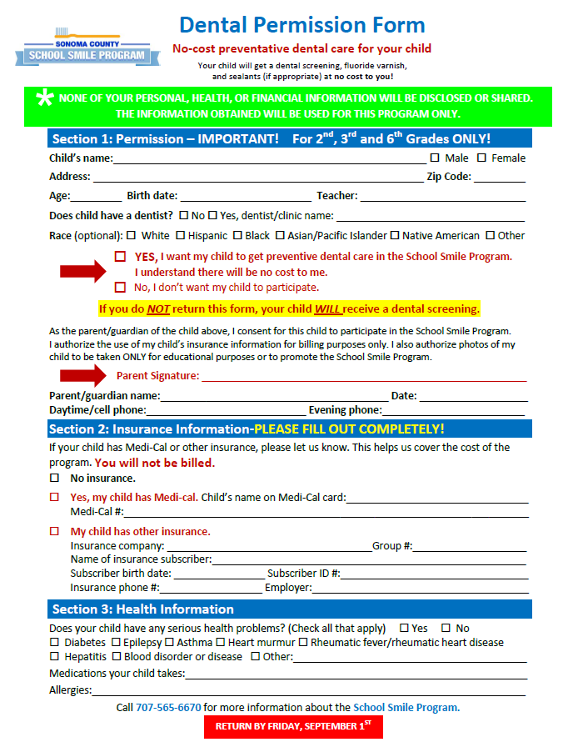
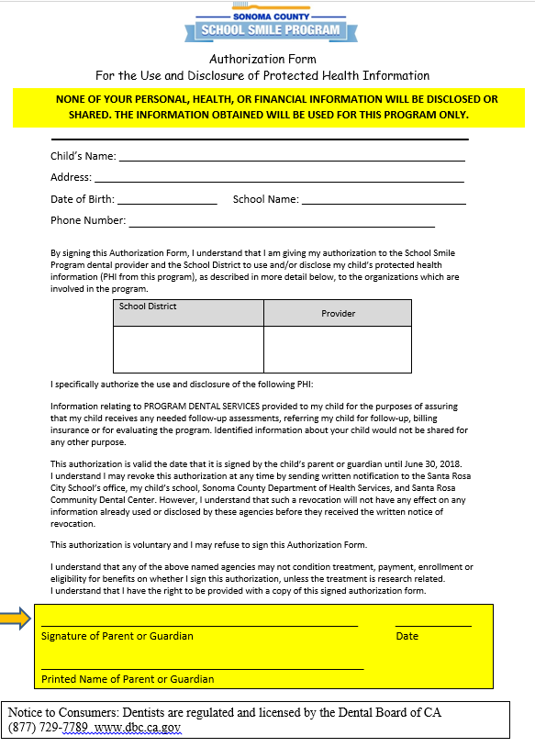
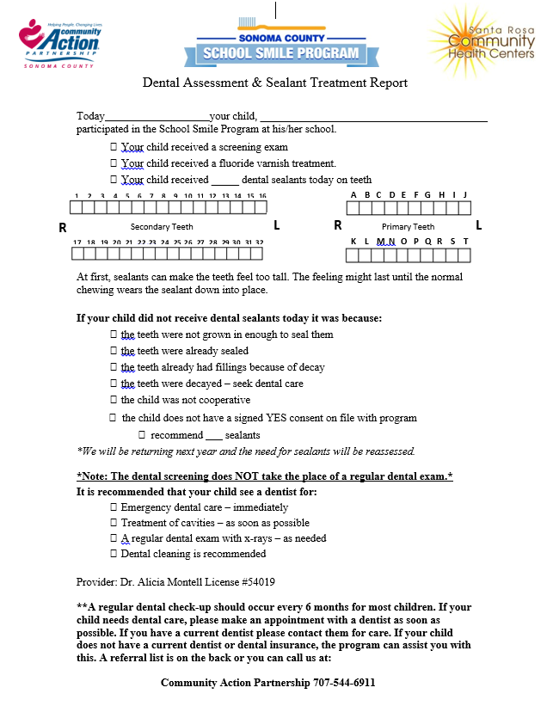
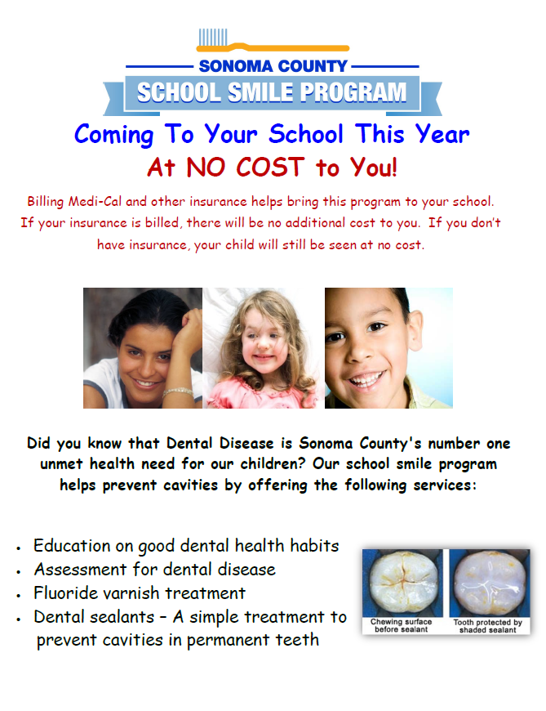
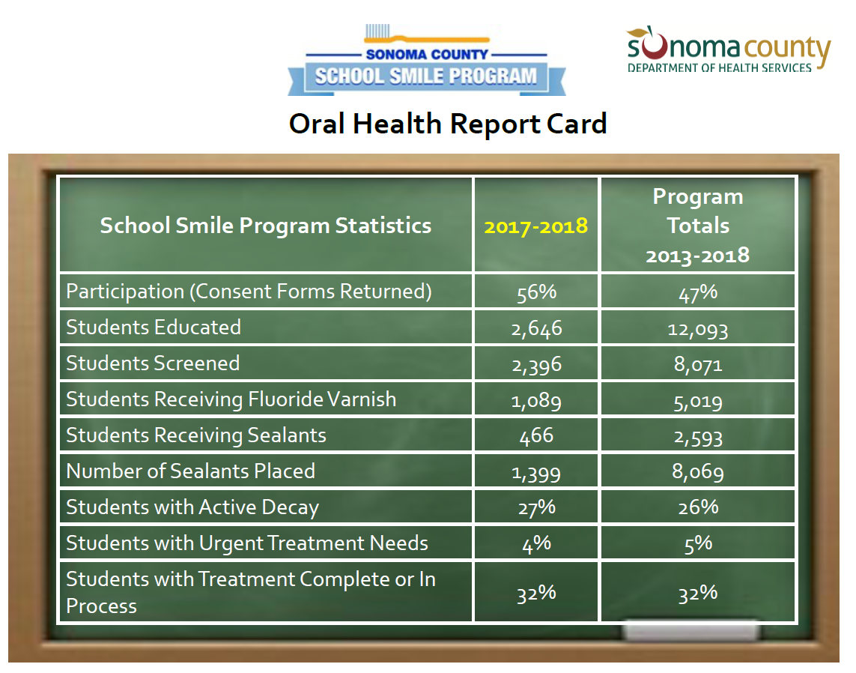
Tools Developed and Tested
Consent forms
HIPPA form
Parent informational flyer
School District MOU example and boilerplate language
Data collection template for analysis and reporting
Graphic Report Cards for schools
School Sealant Manual

Slide 13
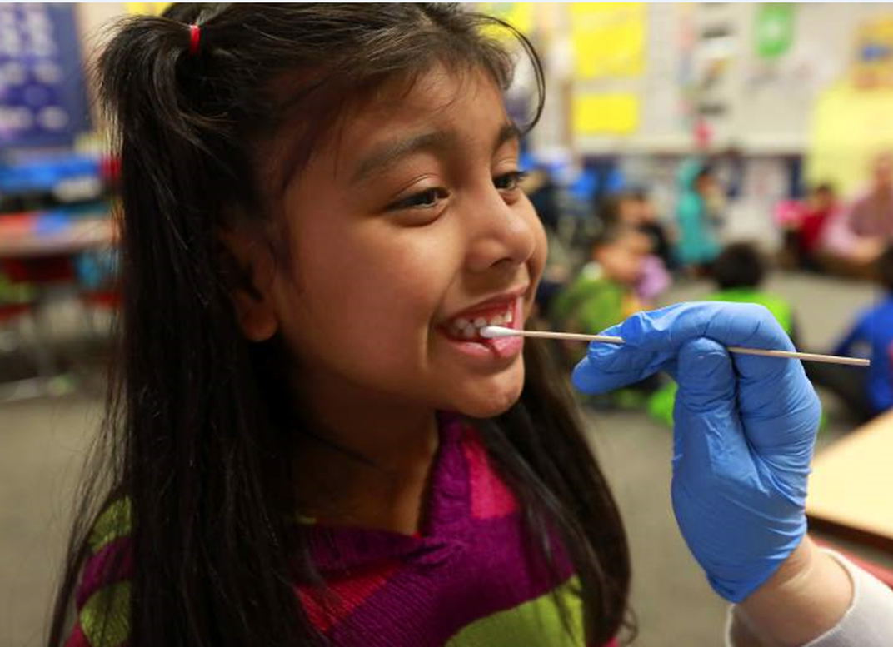
Questions, or for more information:
Andrea Pickett, MPH
Health Information Specialist II
Department of Health Services, Public Health
Email: andrea.pickett@sonoma-county.org
707-565-8693

