Slide 1
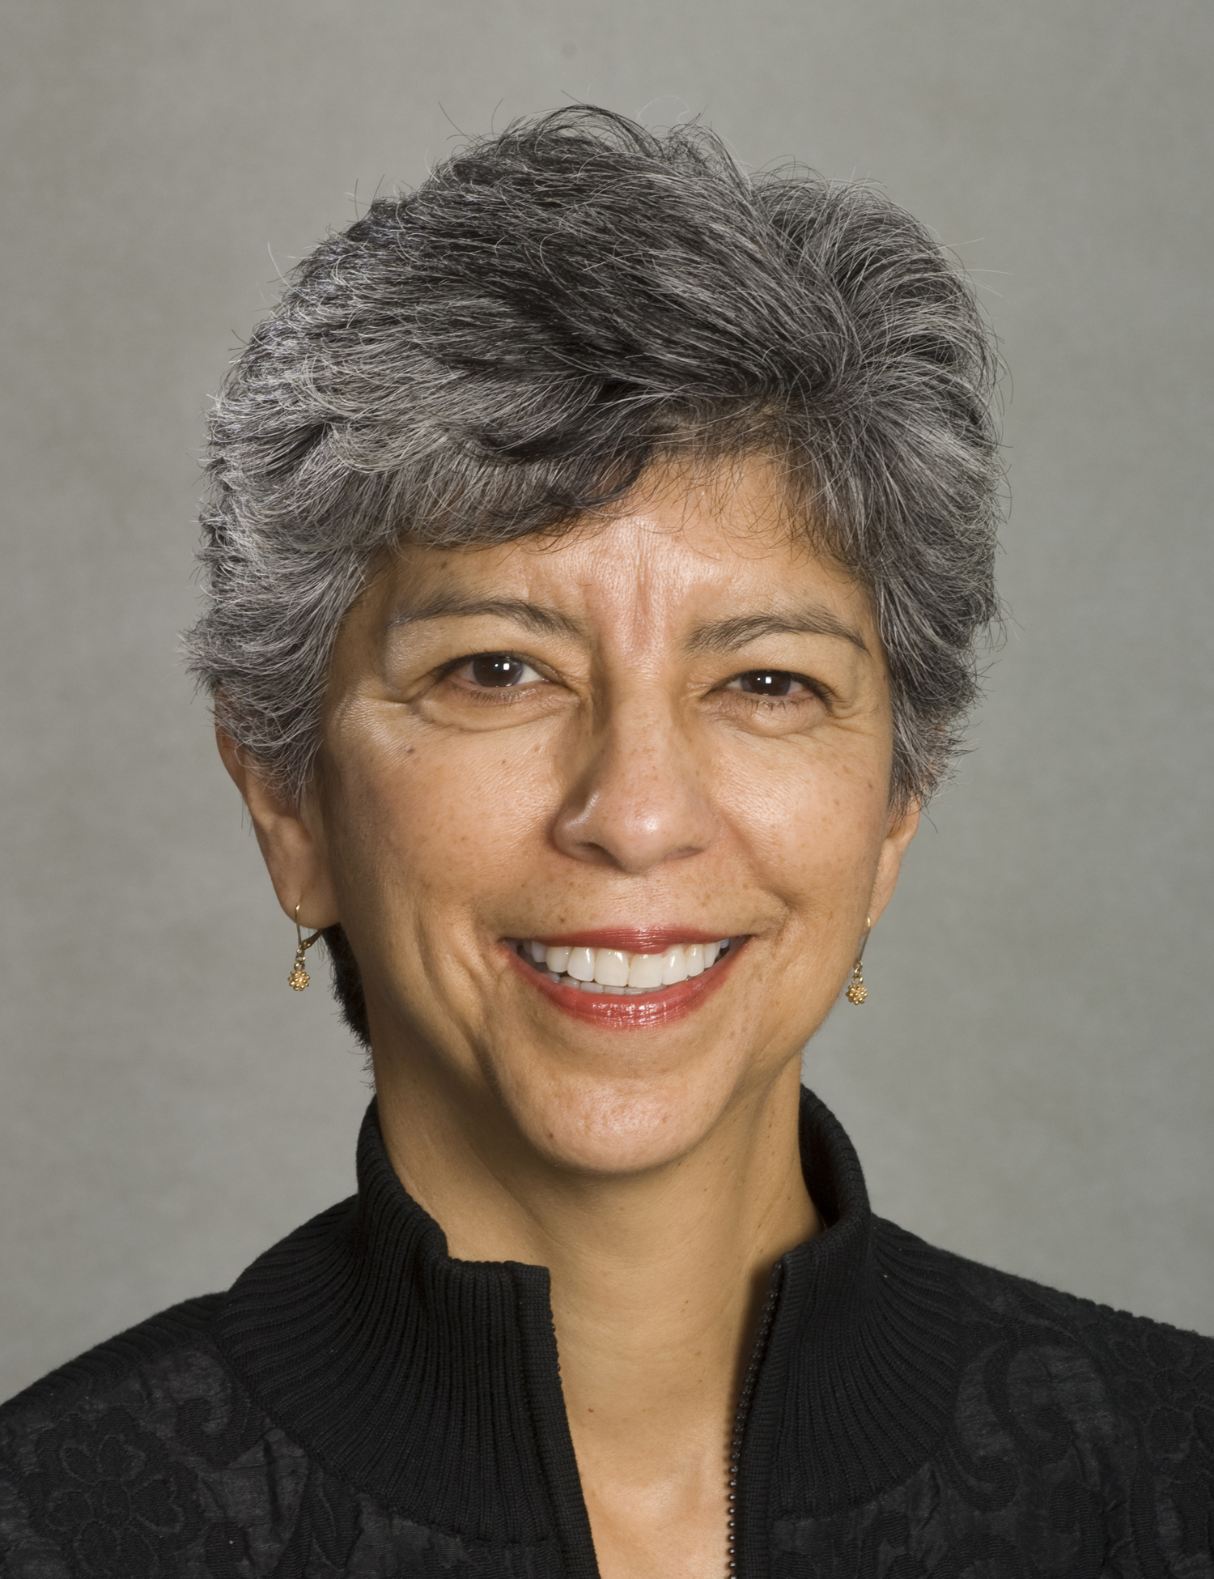
Elena Francisco, RDHAP, MS
RDHAP Program Director
RDHAP Program:
Oral Health for People with Special Needs

Slide 2
What is an RDHAP Program
Continuing Education Course
Regulated through the Dental Hygiene Board of California
Prepares participants to provide dental hygiene care for patients with special needs
Low income children
Those with developmental disabilities
Elderly
Facility bound
Home bound
Patients who live in designated dental professional shortage areas
Prepares RDHs to license as an RDHAP

Slide 3
All RDHAP Programs review oral pathology, pharmacology, medical and dental emergencies, as well as the sociology, psychology and treatment of patients with special needs.
In the UOP Program, we move our participants through the dental hygiene process of care, closing that circle of total care for the patient.
We weave in ethical care and sound business practices to help get them started as a sole proprietor.

Slide 4
The Program faculty and staff are proud of the Dugoni School:
Purpose – To help people lead healthy lives
Vision – Improving health and wellness through innovation in programs, partnerships, and people
Core values – Support the educational model of Humanism
Humanism requires we take responsibility for ourselves and our community, model the highest of standards, and share our knowledge with others in a way that encourages and energizes.

Slide 5
Changes in our program
This program has traditionally included 2 live, in-person sessions.
COVID-19 required us to move our first (reboot) program fully online.
We decided to move the program permanently to an fully online format.
Two live-virtual sessions still on Fridays.

Slide 6
Why fully online?
Travel to San Francisco is:
Expensive
Time consuming
Often inconvenient, especially in these uncertain times
Goal to attract participants from rural areas
There is a down side to not having in-person sessions.

Slide 7
Connecting with RDHAPs/The Missing Link
RDHAPs tend to work in silos.
We want to encourage connecting with each other.
We will have live webinars/chats with practicing RDHAPs.
Field study will be included to create a connection with a local RDHAP.

Slide 8
UOP RDHAP Program goals
Provide students with a broad background in the provision of oral health services for people with a variety of special needs and circumstances.
Providing targeted instruction from experts in their fields, including several practicing RDHAPs.
Prepare students for lifelong learning by sharing:
Downloadable articles and reference materials
Textbooks and resources we can use to provide the best in clinical practice
Links to websites and online resources that provide evidence-based information

Slide 9
Provide students with information necessary to work in alternative practice environments including:
Business principles
Oral health delivery systems
Third party reimbursement systems.
Connect students with a network of professionals:
Practicing RDHAPs share their strategies and resources for beginning a sustainable practice
Create a network among the course participants, the practicing RDHAPs they meet in the program, and the Dugoni School Alumni Association.
The participants always have access to the faculty and staff.
Prepare RDHs for licensure.

Slide 10
Radiographic Decision-Making and Interim Therapeutic Restoration Education
Dugoni School Continuing Dental Education department is currently working with faculty to reboot this course.
One of the strategies they are investigating is how to make the course accessible and affordable to those in rural areas.
This is a Continuing Dental Education program different from the RDHAP program.
We have discussed the possibility of including it in the RDHAP program.
Consider those who may want to access the RDM/ITR training, but not the RDHAP training.
I believe they are considering keeping it a separate offering.

Slide 11
Thank you
Questions?
Contact me at: efrancisco@pacific.edu

