Slide 1
Check out COHTAC’s New Resources & Opportunities
Notes:
Another section header example

Slide 2
Reminder
Materials for the day are posted to our Convening
webpage. Accessible via this QR code (also on folder sticker)
And via the events page on COHTAC website
We will share attendees’ names and contact information
As always, we appreciate your feedback – please take our emailed evaluation survey– coming to you tomorrow
Notes:
Example housekeeping and footer

Slide 3
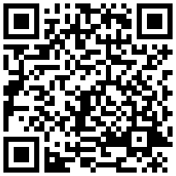
Partnership Opportunity
UCSF Dental Public Health Residency Partnership Opportunity
Research Projects
If you have a supervisor who is a dentist OR holds an MPH
More Information:
oralhealthsupport.ucsf.edu/DPH
Contact Us:
Dr. Sepideh Banava (Deputy Director) Sepideh.Banava@ucsf.edu
UCSF DPH Program dphpostgrad@ucsf.edu
Scan to Start the Process
Notes:
Now we invite Khadijat from COHTAC to lead our networking exercise

Slide 4
https://oralhealthsupport.ucsf.edu/DPH
Notes:
Example housekeeping and footer

Slide 5
DPH Resident Graduates Looking for Jobs
Email COHTAC to share your open positions: oralhealthsupport@ucsf.edu
Notes:
Example housekeeping and footer

Slide 6
School Open Hours
Small group learning collaboratives
Aims to facilitate LOHPs’ implementation of school dental programs
* Interactive * practice-based * encourages cross-learning and resource-sharing
Guidance and facilitation by experts
Monthly meetings for 4-5 months
Please fill out the survey to sign up
Sign up! →
Notes:
Example housekeeping and footer

Slide 7
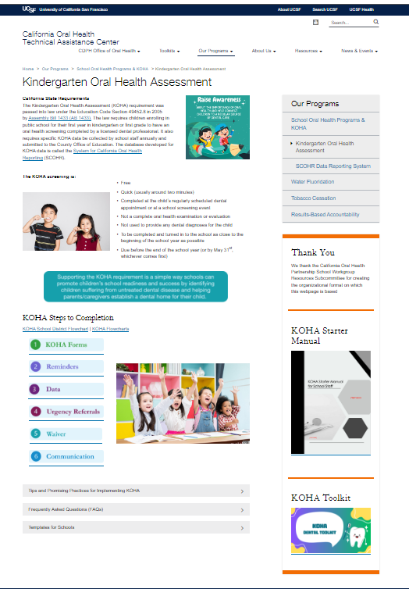
New Webpage
https://oralhealthsupport.ucsf.edu/KOHA
Notes:
Example housekeeping and footer

Slide 8
Stay connected on Slack
LOHP Workspace
Get quick answers to your questions
Share resources with other LOHPs
https://join.slack.com/t/lohp-workspace/shared_invite/zt-28i5jxx11-oUSLHlFKJCGbm9stGkxr1g

Slide 9
Follow COHTAC on Facebook & LinkedIn
Share what your LOHP is up to: oralhealthsupport@ucsf.edu
Facebook
LinkedIn

Slide 10
Wrap Up
Please share your feedback with us – a short evaluation survey will be emailed
All meeting materials will be posted on the event webpage for reference
Notes:
Example housekeeping and footer

Slide 11
Thank You & Safe Travels Home
Notes:
Another section header example

